Slide 1
Rockingham County Comprehensive Transportation Plan (CTP)
Update and Overview
Pam Cook - NCDOT
Emily Stupka - NCDOT
Dawn Vallieres - PTRPO

Slide 2
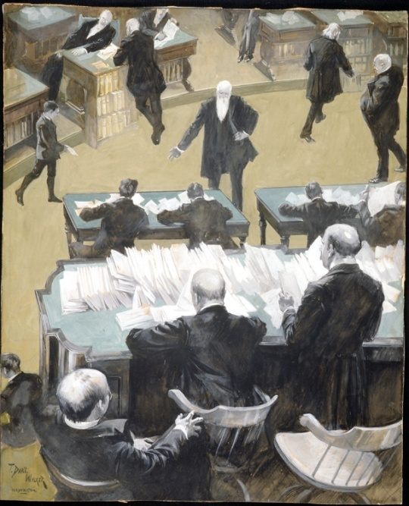
Where did RPOs come from?
Federal: TEA-21 (1998)
  Required ‘rural local official consultation’
State: SB 1195 (2000)
  GS §136-210
32 states use an ‘RPO’ style framework for consultation with rural local officials
Spending Uncle Sam’s Money
– T. Dart Walker (1899)

Slide 3
Why do RPOs exist?
Plan rural transportation systems
Provide consistent opportunities for involvement in decision making
Serve as a resource for information
Provide technical assistance
Speak with a unified voice
Meet a Federal requirement

Slide 4
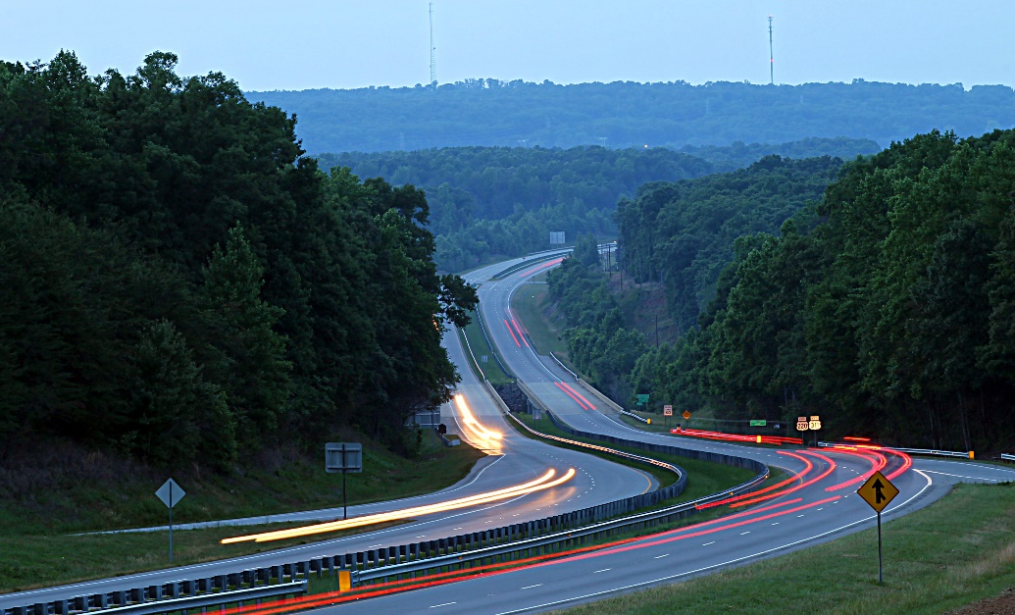

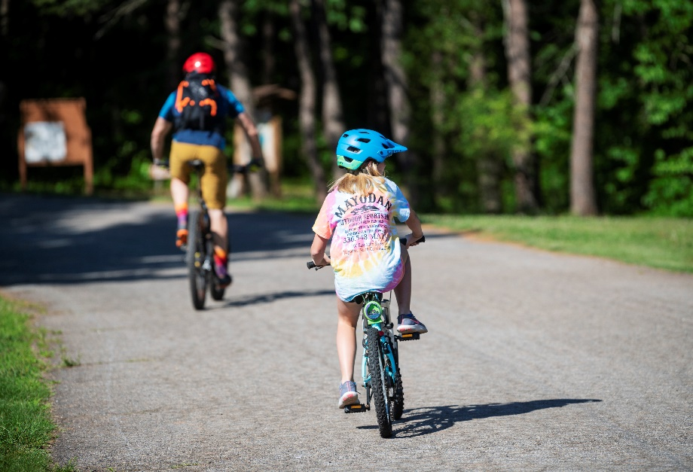
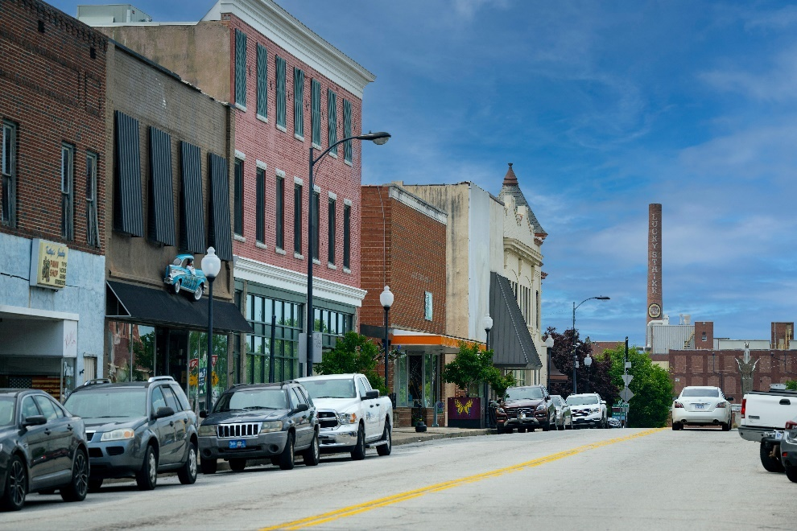
Presentation Outline
Rockingham County CTP Update 1
What is a CTP?
Why are CTPs important?
What is in a CTP?
Rockingham County CTP Progress
Rockingham County CTP Next Steps
Questions

Slide 5
What is a CTP?
Rockingham County CTP Update 1
Comprehensive Transportation Plan
Needs-based, long-range, multi-modal transportation plan looking 25 to 30 years in the future
Considers highway, public transportation, rail, bicycle and pedestrian, as well as airports and freight.
Incorporates land use plans, community & statewide goals, and public input
Developed cooperatively among local stakeholders, the Planning Organization (RPO), and NCDOT

Slide 6
Why are CTPs Important?
Rockingham County CTP Update 1
State Law:
  NCGS§136-66.2 with the cooperation of the Department of Transportation, … shall develop a comprehensive transportation plan that will serve present and anticipated travel demand. Shall be based on the best information available and provide for the safe and effective use of the transportation system.
¹http://www.ncleg.net/EnactedLegislation/Statutes/HTML/BySection/Chapter_136/GS_136-66.2.html
Represents a community’s consensus on their future transportation system to support anticipated growth and development
Mutually adopted by the State of North Carolina

Slide 7
What is in a CTP?
Rockingham County CTP Update 1
Split into two documents
Core Document | Appendix
Summary of Plan Current and Future Conditions Project Recommendations and Maps | CTP Process Project Sheets Technical Data and Analysis Definitions and References

Slide 8
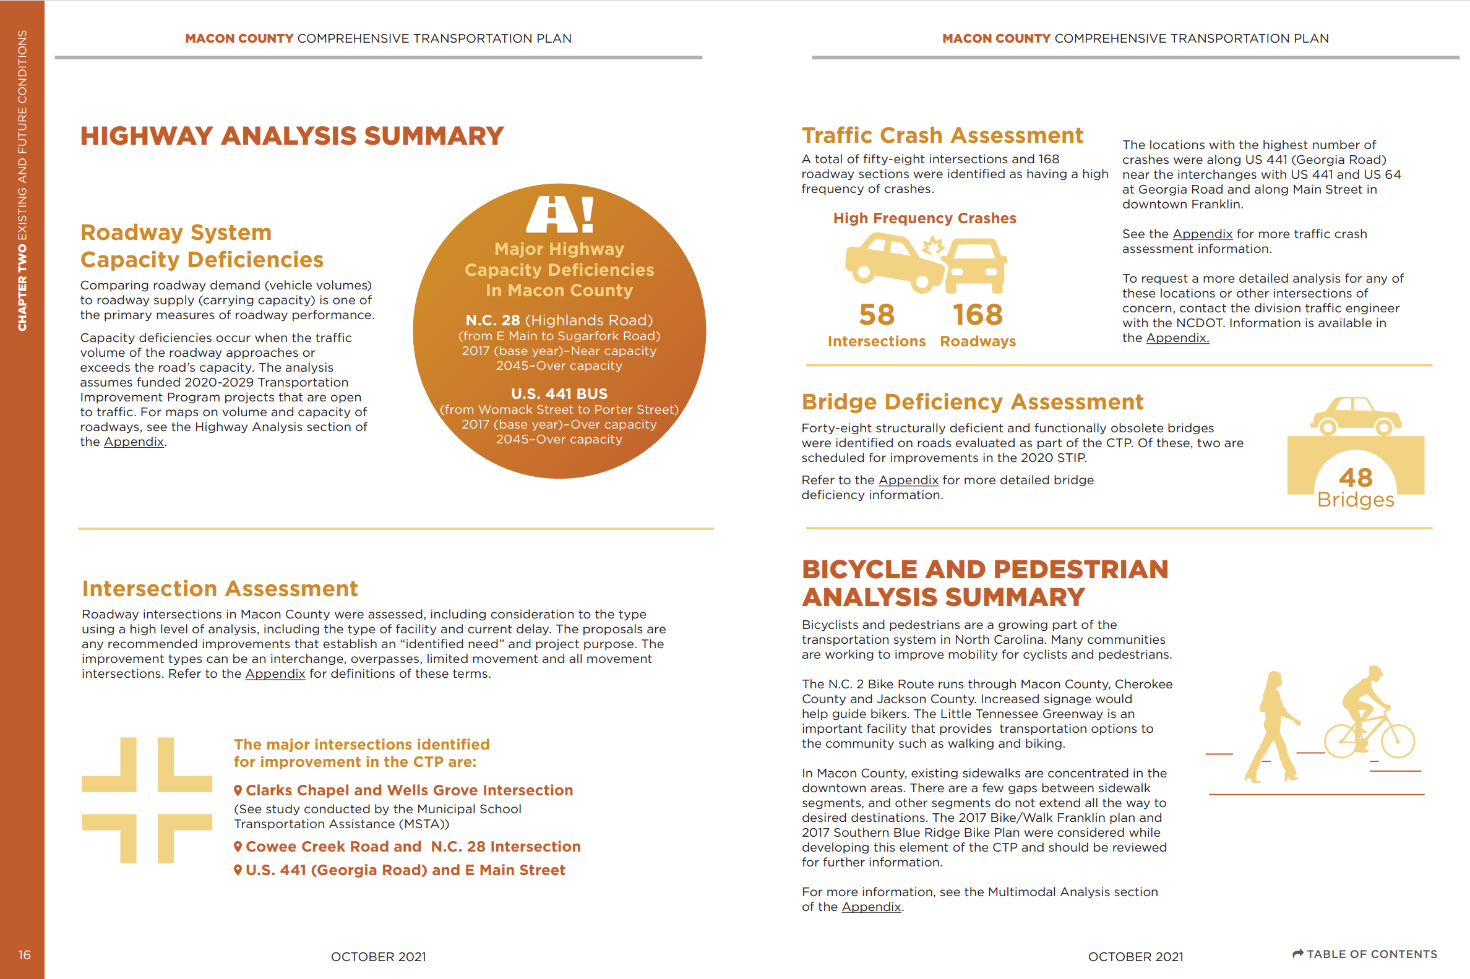
Rockingham County CTP Update 1

Slide 9
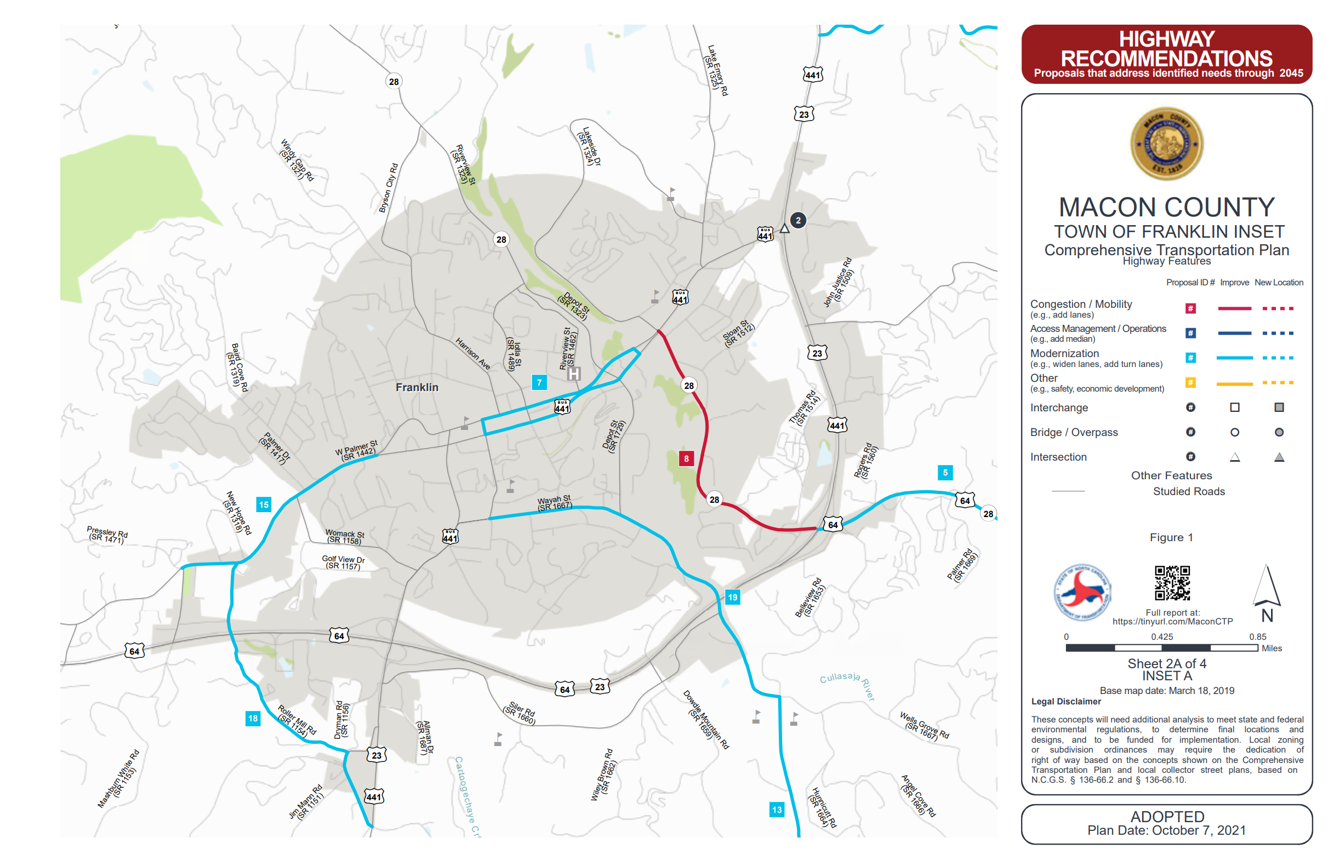
Rockingham County CTP Update 1

Slide 10

Where does the CTP fit into the “Big Picture”?
Rockingham County CTP Update 1
Long-Range Planning CTP
Determining the Need
North Carolina Prioritization Process
Project given a score for funding consideration
Program Development
Funding the Projects
Project Planning
Minimizing the Impacts
Project Design
Design & Right-of-Way (ROW)
Construction, Maintenance, Operations
Building & Maintaining the Road

Slide 11
Current Plans in Rockingham County
Rockingham County CTP Update 1
Rockingham County currently has a CTP that was adopted in 2010 and a Western Rockingham County (Madison/Mayodan) Plan that was adopted in 2014
https://connect.ncdot.gov/projects/planning/Pages/Comprehensive-Transportation-Plans.aspx?county=rockingham
Current legislation requires that local areas have a current land development plan prior to receiving any planning assistance from the Department.
The “Rockingham Vision Plan 2040” that was adopted in May 2021 and amended in March 2022 will be used to meet this requirement.

Slide 12
Rockingham County CTP Update 1
Current legislation (§ 136-66.2.b1) requires that local areas have a current land development plan (less than five years old) prior to receiving any planning assistance from the Department.
(b1) The Department of Transportation may participate in the development and adoption of a transportation plan or updated transportation plan when all local governments within the area covered by the transportation plan have adopted land development plans within the previous five years. The Department of Transportation may participate in the development of a transportation plan if all the municipalities and counties within the area covered by the transportation plan are in the process of developing a land development plan. The Department of Transportation may not adopt or update a transportation plan until a local land development plan has been adopted. A qualifying land development plan may be a comprehensive plan, land use plan, master plan, strategic plan, or any type of plan or policy document that expresses a jurisdiction's goals and objectives for the development of land within that jurisdiction.

Slide 13
Current Plans in Rockingham County
Rockingham County CTP Update 1
Other current plans will also be used to inform the plan, including:
Reidsville Blueway and Greenway Plan (2019)
City of Eden Comprehensive Plan (2022)
City of Eden Comprehensive Pedestrian Plan (2022)
Madison Rivers Trails (2018)
Mayo River State Park Master Plan (2021)
City of Reidsville Land Development Plan (2022)
Stoneville Land Development Plan (2014)
Wentworth Land Use Plan (2006)
2020 Rockingham County Community Health Assessment
Outdoor Recreation Master Plan (Rockingham County) (2023)
Notes:
It is coordinated effort
As mentioned before; recommendations help guide the RPO to submit projects for consideration
It is a common long range vision among various parties

Slide 14



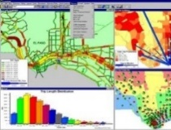
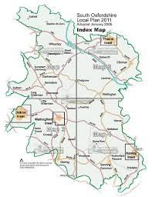



Rockingham County CTP Timeline
Oct 2023-
Feb 2024
March 2024-
August 2024
Aug 2024-
Jan 2025
Oct 2024-
Jan 2025
Jan 2025
Dec 2025
Jan 2026-
June 2026
July 2026
2023
Spring 2024
Develop Vision
System Assessment
Analyze Alternatives
Develop
Draft Plan
Adopt
Plan
CTP
Set-Up
CTP
Close-Out
Initiate Study & Gather data
Hold Initial Meetings
Perform Base year Analysis
Evaluate Constraints
Agree on
“Draft” Plan
Seek
Local Adoption
Distribute
Adopted
Plan
Develop Community Vision
Perform Multi-modal Analysis
Evaluate Future Year Solutions
Complete Plan
Seek
BOT Adoption
Establish
Study Scope
Archive
Project file
Select Roads to study
Perform Future year Analyses
Validate Plan against Vision
Prepare Meeting
Basics
Publish
CTP

Slide 15
CTP Steering Committee
Members
NCDOT TPD
Division 7 Staff
Piedmont Triad RPO
Local Stakeholders
County
Municipalities
Economic development
Multi-modal reps
Agricultural/environmental interests
Schools
Medical Centers
Roles
Represent stakeholders in the county
Assist with public engagement
Share unique perspective during the planning process
Review plan as it is developed
Inform others about the CTP
Assist with adoption and endorsement
It is not too late to join:
If you are interested in being a Steering Committee Member or in presenting about a topic to our members, please contact us.

Slide 16
CTP Steering Committee
Rockingham County CTP Update 1
Member
Dillon Brown | Stoneville Parks and Recreation
Gini Cardwell | Insurance, Madison
Lynn Cochran | Senior Planner, Rockingham County
Cris Cox | Rockingham County Schools
Jason Hardin | Reidsville Planning & Community Development
Richard Hicks | Mayodan
Hiram Marziano | Community Development, Rockingham County
Lee Mitchell | Madison-Mayodan Recreation
Lindsay Pegg | Rockingham County Tourism
Cathy Powers | Aging, Disability & Transit Services
Kelly Stultz | Eden Planning & Community Development
Erselle Young | Rockingham County Schools
Yvonne Russell | Wentworth
Dawn Vallieres | PTRPO
Pam Cook | NCDOT Rockingham County CTP Project Manager
Emily Stupka | NCDOT Rockingham County CTP Project Engineer
Marty Sung | NCDOT TPD PTRPO Coordinator

Slide 17
Status Update
Rockingham County CTP Update 1
Completion of a Community Understanding Report for the County
Stakeholders identified/CTP Steering Committee established
Roads to be evaluated from a vehicular mode have been identified.
Draft Vision Statement and Goals
Identification of low and high growth areas
Identification of current volume to capacity deficiencies
Identification of Key Destinations and access by modal type
Development of first Public Engagement Survey to inform Vision and Goals

Slide 18
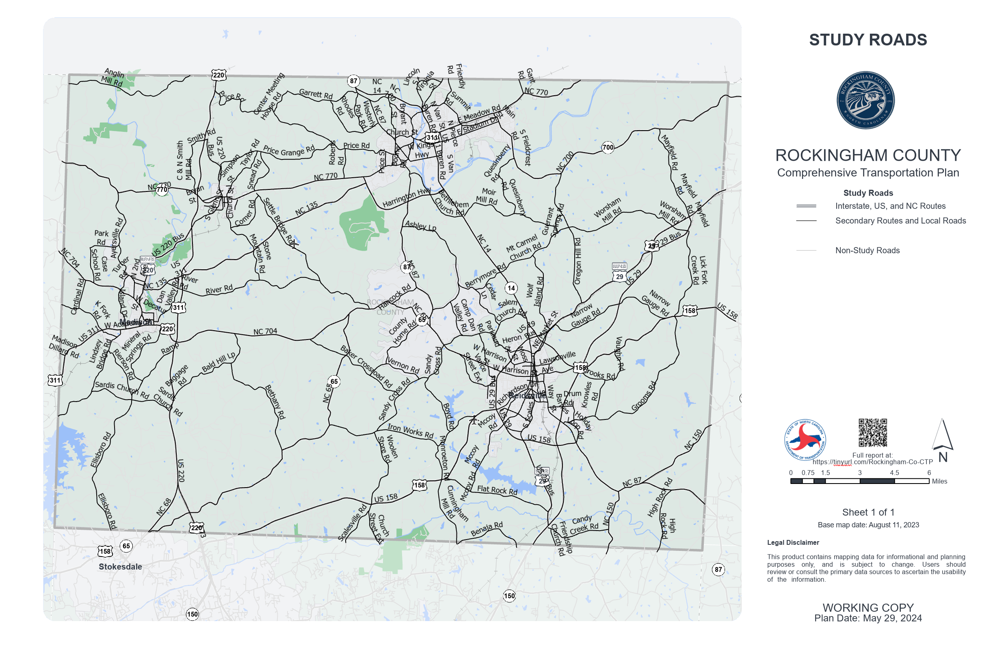
Study Roads
Rockingham County CTP Update 1

Slide 19
Draft Vision
Rockingham County CTP Update 1
Rockingham County has a safe, well-maintained, accessible, efficient, and convenient multi-modal transportation system that removes barriers while connecting its residents and visitors of all ages and abilities to their destinations within the county and regionally that minimizes impacts to the natural environment and supports economic and community growth.

Slide 20
Draft Goals & Objectives
Rockingham County CTP Update 1
The roads in Rockingham County are well-maintained.
  Objective: Encourage state-maintained roads instead of locally maintained roads (Rockingham County currently has XXXX miles of locally maintained roads).
Traveling to destinations and between destinations in Rockingham County is efficient and convenient.
  Rockingham County is destination focused, considering development of access to destinations as roads are improved and new development is built.
  Objective: Roads between municipalities, outdoor destinations, and other key destinations are comfortable to drive, with sufficient lane width, and paved shoulders at a minimum.
  There are designated and marked bike routes with signage.
  Recreational areas throughout the county are accessible by all modes.
    There is a signage system that guides residents and visitors to key recreational areas throughout the county.
    Area maps identify recreational areas.
(Continued on next slide)

Slide 21
Draft Goals & Objectives
Rockingham County CTP Update 1
3. Rockingham County has a safe and accessible multi-modal transportation system.
  There are safe facilities for vehicles, pedestrians, and bicyclists.
  Residents have access to public transportation.
    There is an on-demand public transportation system.
    Facilities support pedestrians and bicyclists.
    Sidewalks and Greenways meet ADA requirements.
  Connected sidewalks and greenways without gaps.
    Increase existing connectivity by filling in gaps.
  Incorporate complete streets where possible.
    Complete streets is a policy and design approach that considers bikes, pedestrians, public transportation, and vehicles.
4. Protection of existing watersheds is a priority.
  Encourage cluster development within the watershed (area of land that drains water into a waterbody).
    Reduce lot sizes and setbacks to promote conservation of open space.
    Minimize stream buffer impacts.

Slide 22
Key Destinations have been Identified
Rockingham County CTP Update 1
Behavioral Health Urgent Care Center (Wentworth)
Boone Road Community Building
Boys and Girls Club of Eden
Bridge St Rec Center
Community College
Community Parks (All)
Cone Health at Annie Penn
Downtowns of all municipalities
Eden Public Library
Garden of Eden Senior Center
Haw River State Park
Industrial Parks (All)
Judicial Center
Key Destination
Lake Reidsville
Lowes Grocery (Reidsville)
Lowes Home Improvement (Mayodan)
M & M Rec Center
Madison and Mayodan Park and Rec Department and Senior Center
Madison Dry Goods and Country Store + Lawson Family Tragedy Museum
Madison- Mayodan Public Library
Mayo River State Park
Mayodan Arts Center
Mill Ave Rec Center
Museums (All)
Reidsville Center for Active Retirement Enterprise
Reidsville Family YMCA
Reidsville Farmer’s Market/Downtown Square
Reidsville Public Library
Reidsville Teen Center
Rockingham County Arts Council
Rockingham Governmental Center (Department of Social Services and Health Department)
Rockingham Showcase
Schools (Private, Elementary, Middle, High)
Sky’s the Limit All-Inclusive Park
Stoneville Public Library
Theatre Guild of Rockingham
UNC Health Rockingham
Walking/Nature Trails (All)
Walmart (Eden)
Walmart (Mayodan)
Walmart (Reidsville)
Western Rockingham Farmers Market (Seasonal)
YMCA – F.C Buck Dumain Youth Center

Slide 23
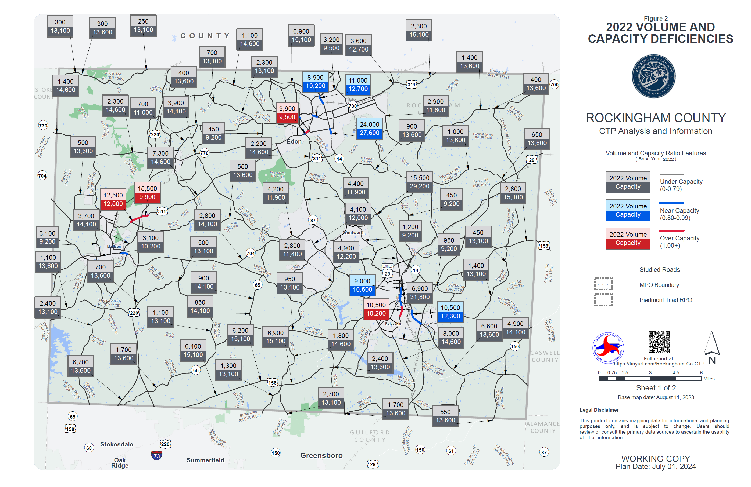
2022 Volume/Capacity Analysis
Rockingham County CTP Update 1

Slide 24
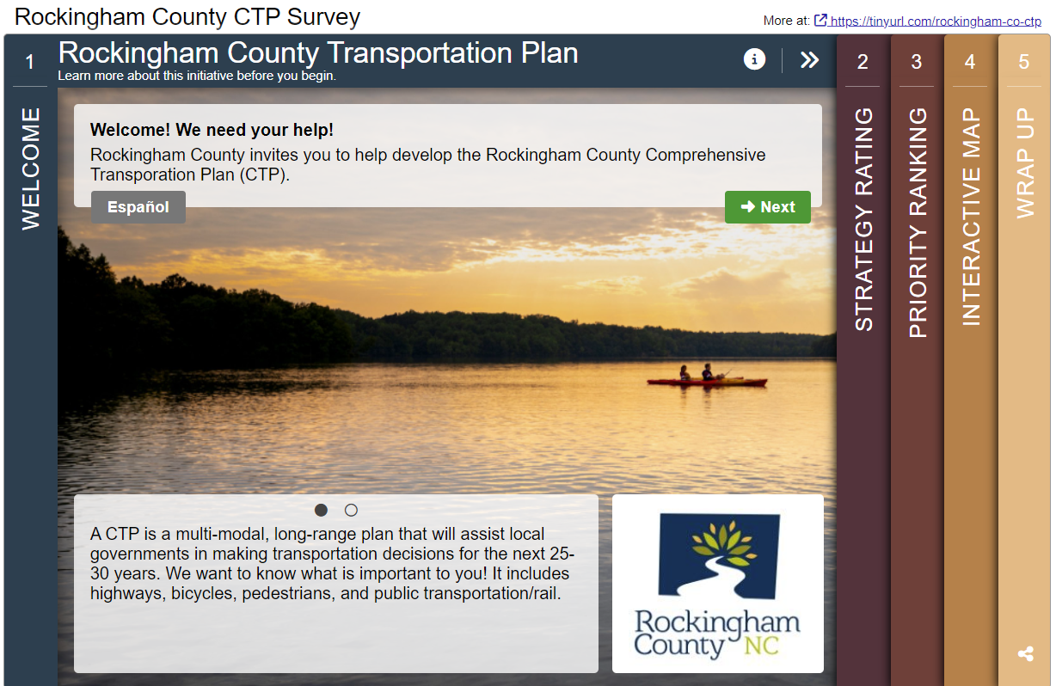
Vision, Goals and Objectives Survey
https://tinyurl.com/Rockingham-Co-CTP
* The Survey will close on July 21, 2024.
Topics on survey:
Strategy Rating – What is important to you?
Priority Ranking – Ranking of goals
Interactive Maps – Identify concerns

Slide 25
Next Steps (August-October)
Rockingham County CTP Update 1
Review Survey Results
Review Vision, Goals & Objectives
Safety Data and Crash Locations Overview
Overview of the NCDOT Prioritization Process and STIP (How a project goes from Plan to Implementation)
Population and Employment Growth Discussion
Review Base Year Conditions: All Modes
EMS Staff Concerns/Perspective

Slide 26
Contacts
Rockingham County CTP Update 1
Piedmont Triad Rural Planning Organization (RPO)
  Dawn Vallieres, dvallieres@ptrc.org,
  (336) 904-0300
NCDOT Transportation Planning Division (TPD)
  Emily Stupka, elstupka@ncdot.gov,
  (919)-707-0985 (Project Engineer)
  Pam Cook, P.E., prcook@ncdot.gov, (919) 707-0975 (Project Manager)

Slide 27
Thank you!
Questions?

